Slide 1
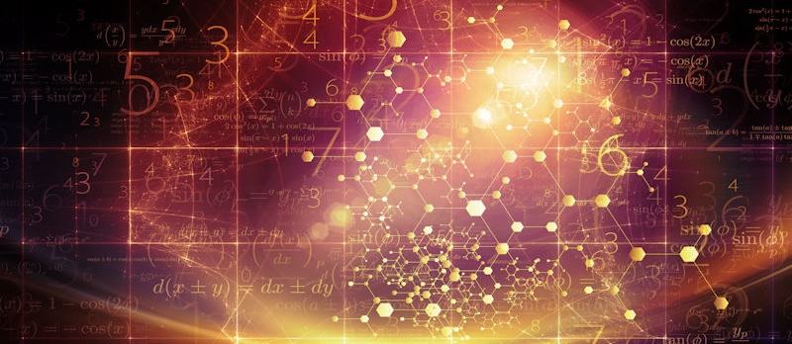
Introduction to Probabilistic Machine Learning
Ralf Herbrich, Rainer Schlosser
Inference & Decision Making

Slide 2
Overview
Inference Methods
Bayesian Inference
Maximum Likelihood Estimation
Decision Making

Slide 3
Overview
Inference Methods
Bayesian Inference
Maximum Likelihood Estimation
Decision Making

Slide 4
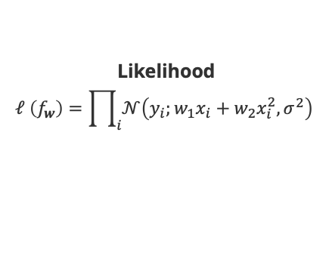
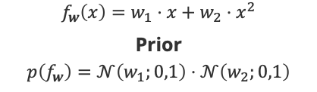

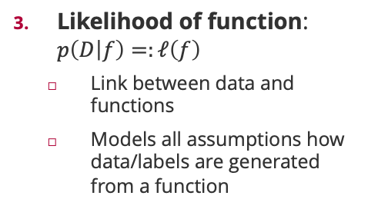
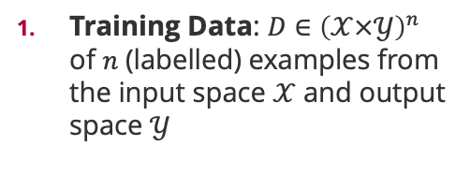
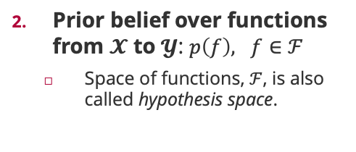
Probabilistic Machine Learning: Ingredients
Training Data: $D∈{\left(𝒳×𝒴\right)}^{n}$ of $n$ (labelled) examples from the input space $𝒳$ and output space $𝒴$
Prior belief over functions from $𝓧$ to $𝓨$: $p\left(f\right), f∈ℱ$
Space of functions, $ℱ$, is also called hypothesis space.
Likelihood of function: $p\left(D | f\right)=:ℓ\left(f\right)$
Link between data and functions
Models all assumptions how data/labels are generated from a function
$$f_{w}\left(x\right)=w_{1}⋅x+w_{2}⋅x^{2}$$
Prior
$$p\left(f_{w}\right)=𝒩\left(w_{1};0,1\right)⋅𝒩\left(w_{2};0,1\right)$$
Likelihood
$$ℓ \left(f_{w}\right)=\prod_{i}{𝒩\left(y_{i};w_{1}x_{i}+w_{2}x_{i}^{2},σ^{2}\right)}$$
Training Data
$$D⊂ℝ^{2}$$

Slide 5






Key Question I: Inference and Predictive Distribution
Total probability rule
Predictive Distribution. Given a training set $D∈{\left(𝒳×𝒴\right)}^{n}$ and a new input point $x∈𝒳$, the distribution $p\left(y|x,D\right)=∫p\left(y|x,f\right)⋅p\left(f|D\right) df$ of target values $y∈𝒴$ at the input point $x$ is called the predictive distribution.
Observation 1: For any function $f∈ℱ$ from the hypothesis space, the likelihood is already the distribution $p\left(y|x,f\right)$!
Observation 2: Each function $f∈ℱ$ from the hypothesis space has a posterior belief $p\left(f|D\right)$ after we have observed the training data using Bayes’ rule!
``
$$P\left(y|x,f_{w}\right)$$
$$p\left(f | D\right)=\frac{p\left(D|f\right)⋅p\left(f\right)}{p\left(D\right)}$$
$$P\left(f_{w}|D\right)$$
$$P\left(D|f_{w}\right)$$
$$P\left(f_{w}\right)$$

Slide 6
Overview
Inference Methods
Bayesian Inference
Maximum Likelihood Estimation
Decision Making

Slide 7

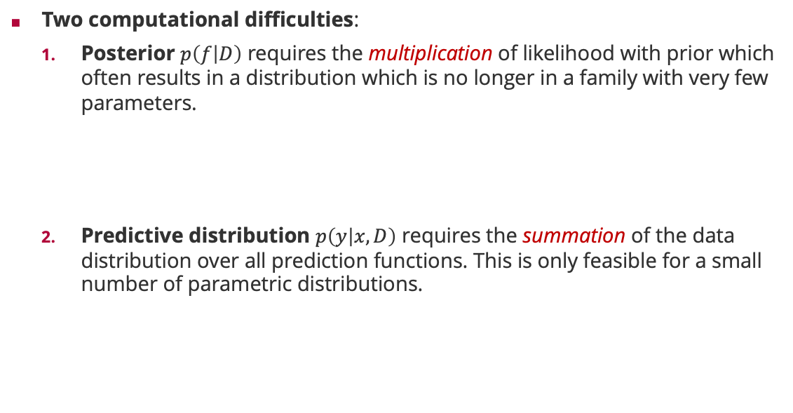

Probabilistic Machine Learning: Bayesian Inference
Two computational difficulties:
Posterior $p\left(f | D\right)$ requires the multiplication of likelihood with prior which often results in a distribution which is no longer in a family with very few parameters.
Predictive distribution $p\left(y | x,D\right)$ requires the summation of the data distribution over all prediction functions. This is only feasible for a small number of parametric distributions.
$$p\left(f | D\right)=\frac{p\left(D|f\right)⋅p\left(f\right)}{p\left(D\right)}$$
$$∝ℓ\left(f\right)⋅p\left(f\right)$$
$$p\left(y|x,D\right)=∫p\left(y|x,f\right)⋅p\left(f|D\right) df$$

Slide 8

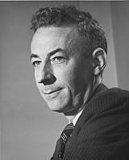
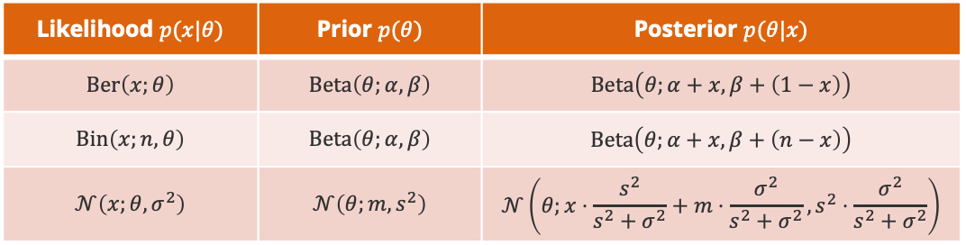
Probability Distributions: Conjugacy
Bayes Rule for Random Variables. For any probability distribution $p$ over two random variables $X$ and $Θ$, it holds
$$p\left(θ|x\right)=\frac{p\left(x|θ\right)⋅p\left(θ\right)}{p\left(x\right)}$$
Conjugacy. A family ${\left\{p\left(x,θ\right)\right\}}_{x,θ}$ is conjugate if the posterior $p\left(θ|x\right)$ is part of the same family as the prior $p\left(θ\right)$ for any value of $x$.
Big Advantage: Computing the exact posterior is computationally efficient!
Likelihood
$$p\left(x,θ\right)$$
Howard Raiffa (1924 – 2016)
Posterior
Prior
Likelihood $p(x|θ)$ | Prior $p(θ)$ | Posterior $p(θ|x)$
$$Ber\left(x;θ\right)$$ | $$Beta\left(θ;α,β\right)$$ | $$Beta\left(θ;α+x,β+\left(1−x\right)\right)$$
$$Bin\left(x;n,θ\right)$$ | $$Beta\left(θ;α,β\right)$$ | $$Beta\left(θ;α+x,β+\left(n−x\right)\right)$$
$$𝒩\left(x;θ,σ^{2}\right)$$ | $$𝒩\left(θ;m,s^{2}\right)$$ | $$𝒩\left(θ;x⋅\frac{s^{2}}{s^{2}+σ^{2}}+m⋅\frac{σ^{2}}{s^{2}+σ^{2}},s^{2}⋅\frac{σ^{2}}{s^{2}+σ^{2}}\right)$$
Robert Osher Schlaifer (1914 – 1994)

Slide 9
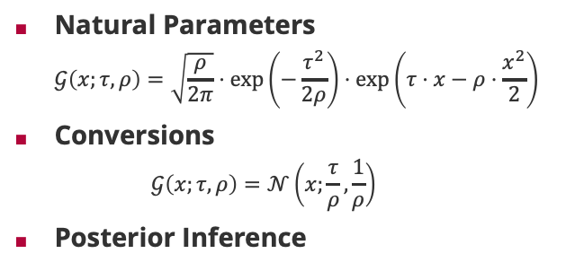
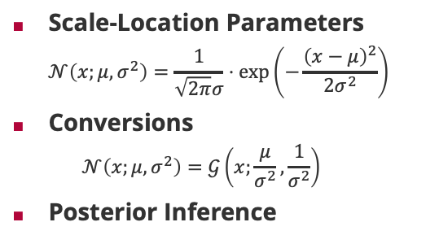
Normal Distribution: Representations
Scale-Location Parameters
$$𝒩\left(x;μ,σ^{2}\right)=\frac{1}{\sqrt{2π}σ}⋅\exp\left(−\frac{{\left(x−μ\right)}^{2}}{2σ^{2}}\right)$$
Conversions
$$𝒩\left(x;μ,σ^{2}\right)=𝒢\left(x;\frac{μ}{σ^{2}},\frac{1}{σ^{2}}\right)$$
Posterior Inference
Natural Parameters
$$𝒢\left(x;τ,ρ\right)=\sqrt{\frac{ρ}{2π}}⋅\exp\left(−\frac{τ^{2}}{2ρ}\right)⋅\exp\left(τ⋅x−ρ⋅\frac{x^{2}}{2}\right)$$
Conversions
$$𝒢\left(x;τ,ρ\right)=𝒩\left(x;\frac{τ}{ρ},\frac{1}{ρ}\right)$$
Posterior Inference
Two divisions only!

Slide 10
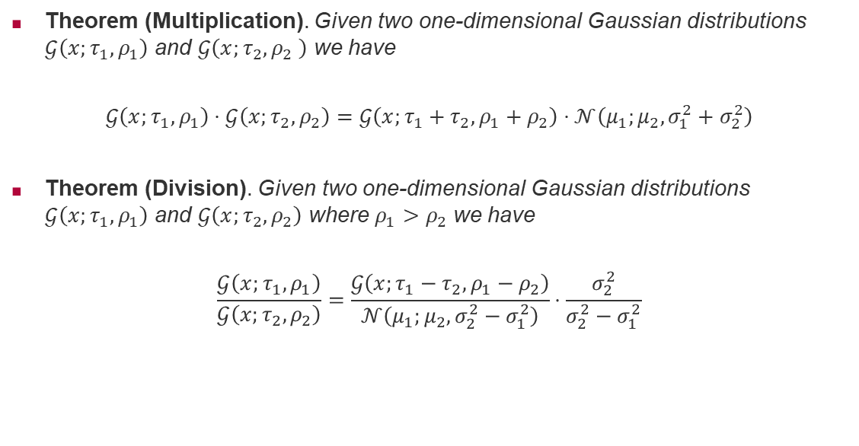
Normal Distributions: Efficient Products & Divisions
Theorem (Multiplication). Given two one-dimensional Gaussian distributions $𝒢\left(x;τ_{1},ρ_{1}\right)$ and $𝒢\left(x;τ_{2},ρ_{2} \right)$ we have
$$𝒢\left(x;τ_{1},ρ_{1}\right)⋅𝒢\left(x;τ_{2},ρ_{2}\right)=𝒢\left(x;τ_{1}+τ_{2},ρ_{1}+ρ_{2}\right)⋅𝒩\left(μ_{1};μ_{2},σ_{1}^{2}+σ_{2}^{2}\right)$$
Theorem (Division). Given two one-dimensional Gaussian distributions $𝒢\left(x;τ_{1},ρ_{1}\right)$ and $𝒢\left(x;τ_{2},ρ_{2}\right)$ where $ρ_{1}>ρ_{2}$ we have
$$\frac{𝒢\left(x;τ_{1},ρ_{1}\right)}{𝒢\left(x;τ_{2},ρ_{2}\right)}=\frac{𝒢\left(x;τ_{1}−τ_{2},ρ_{1}−ρ_{2}\right)}{𝒩\left(μ_{1};μ_{2},σ_{2}^{2}−σ_{1}^{2}\right)}⋅\frac{σ_{2}^{2}}{σ_{2}^{2}−σ_{1}^{2}}$$
Gaussian density
Additive updates!
Correction factor
Subtractive updates!
Gaussian density

Slide 11
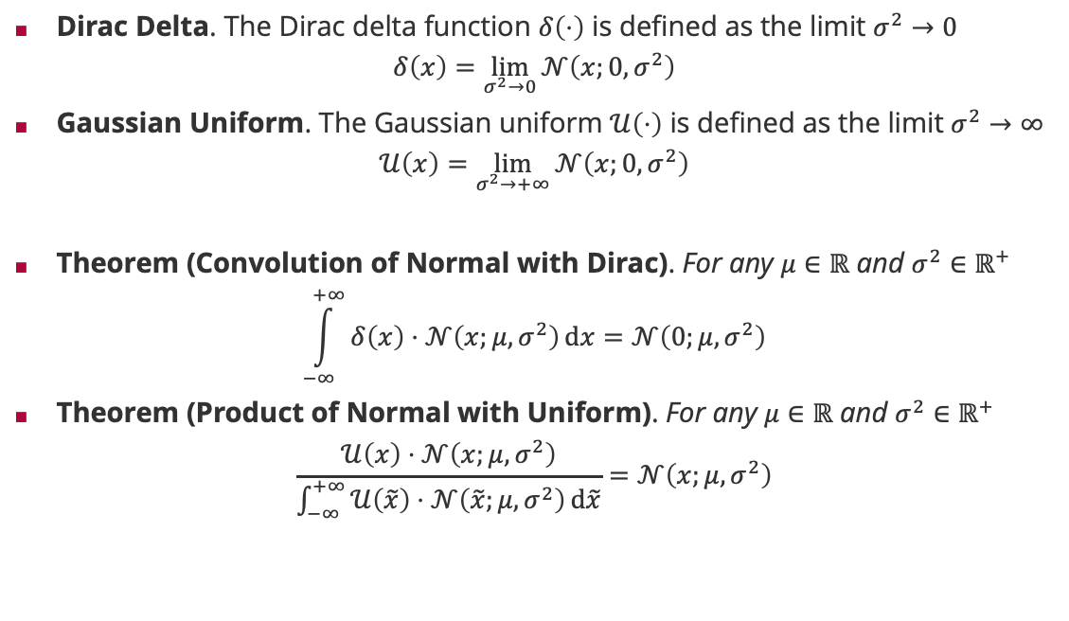

Limit Normal Distributions: Dirac Delta and Uniform
Dirac Delta. The Dirac delta function $δ\left(⋅\right)$ is defined as the limit $σ^{2}→0$
$$δ\left(x\right)=\lim_{σ^{2}→0}{𝒩\left(x;0,σ^{2}\right)}$$
Gaussian Uniform. The Gaussian uniform $𝒰\left(⋅\right)$ is defined as the limit $σ^{2}→∞$
$$𝒰\left(x\right)=\lim_{σ^{2}→+∞}{𝒩\left(x;0,σ^{2}\right)}$$
Theorem (Convolution of Normal with Dirac). For any $μ∈ℝ$ and $σ^{2}∈ℝ^{+}$
$$\int_{−∞}^{+∞}{δ\left(x\right)⋅𝒩\left(x;μ,σ^{2}\right)}dx=𝒩\left(0;μ,σ^{2}\right)$$
Theorem (Product of Normal with Uniform). For any $μ∈ℝ$ and $σ^{2}∈ℝ^{+}$
$$\frac{𝒰\left(x\right)⋅𝒩\left(x;μ,σ^{2}\right)}{\int_{−∞}^{+∞}{𝒰\left(\tilde{x}\right)⋅𝒩\left(\tilde{x};μ,σ^{2}\right)}d\tilde{x}}=𝒩\left(x;μ,σ^{2}\right)$$
Gaussian density at $x=0$
Equivalent to multiplying with 1

Slide 12
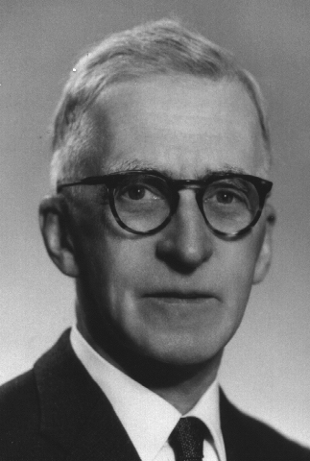
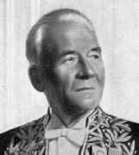
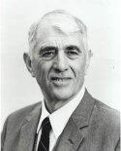
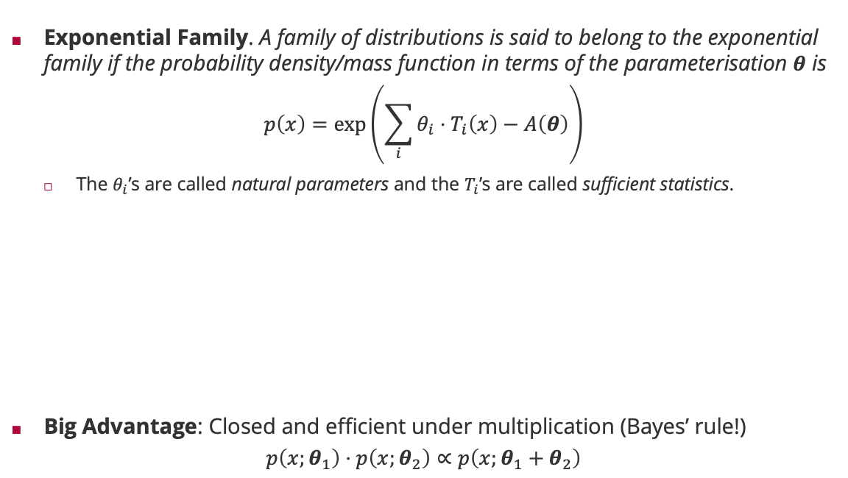
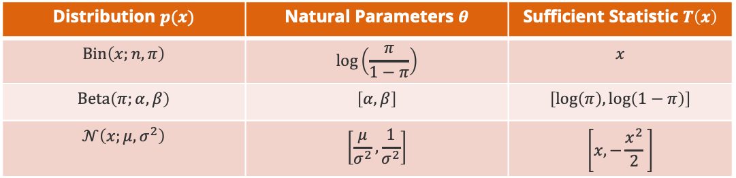
Probability Distributions: Exponential Family
Exponential Family. A family of distributions is said to belong to the exponential family if the probability density/mass function in terms of the parameterisation $θ$ is
$$p\left(x\right)=\exp\left(\sum_{i}{θ_{i}⋅T_{i}\left(x\right)}−A\left(θ\right)\right)$$
The $θ_{i}$’s are called natural parameters and the $T_{i}$’s are called sufficient statistics.
Big Advantage: Closed and efficient under multiplication (Bayes’ rule!)
$$p\left(x;θ_{1}\right)⋅p\left(x;θ_{2}\right)∝p\left(x;θ_{1}+θ_{2}\right)$$
Edwin Pitman (1897 - 1993)
Georges Darmois (1888 - 1960)
Distribution $p(x)$ | Natural Parameters $θ$ | Sufficient Statistic $T\left(x\right)$
$$Bin\left(x;n,π\right)$$ | $$\log\left(\frac{π}{1−π}\right)$$ | $$x$$
$$Beta\left(π;α,β\right)$$ | $$\left[α,β\right]$$ | $$\left[\log\left(π\right),\log\left(1−π\right)\right]$$
$$𝒩\left(x;μ,σ^{2}\right)$$ | $$\left[\frac{μ}{σ^{2}},\frac{1}{σ^{2}}\right]$$ | $$\left[x,−\frac{x^{2}}{2} \right]$$
Bernhard Koopman (1900 - 1991)

Slide 13
Overview
Inference Methods
Bayesian Inference
Maximum Likelihood Estimation
Decision Making

Slide 14
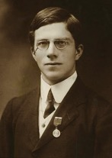
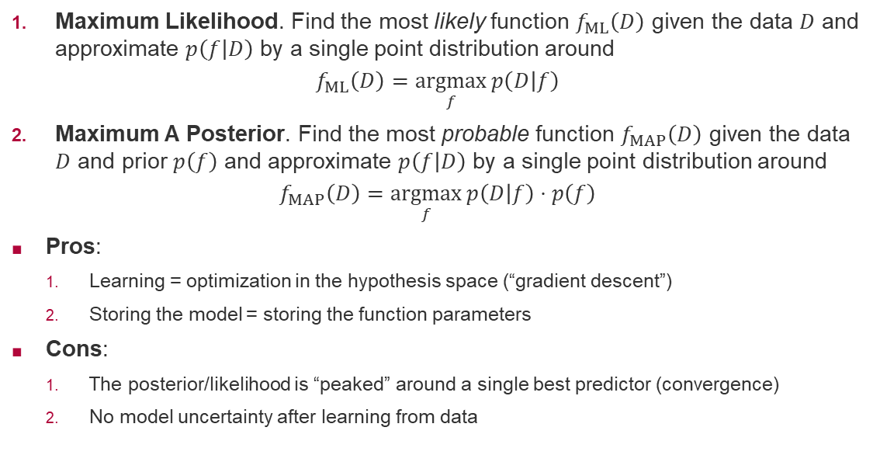
Maximum Likelihood/Maximum A-Posteriori Inference
Maximum Likelihood. Find the most likely function $f_{ML}\left(D\right)$ given the data $D$ and approximate $p\left(f | D\right)$ by a single point distribution around
$$f_{ML}\left(D\right)=\underset{f}{argmax}{p\left(D | f\right)}$$
Maximum A Posterior. Find the most probable function $f_{MAP}\left(D\right)$ given the data $D$ and prior $p\left(f\right)$ and approximate $p\left(f | D\right)$ by a single point distribution around
$$f_{MAP}\left(D\right)=\underset{f}{argmax}{p\left(D | f\right)⋅p\left(f\right)}$$
Pros:
Learning = optimization in the hypothesis space (“gradient descent”)
Storing the model = storing the function parameters
Cons:
The posterior/likelihood is “peaked” around a single best predictor (convergence)
No model uncertainty after learning from data
Sir Ronald Fisher (1890 – 1962)

Slide 15
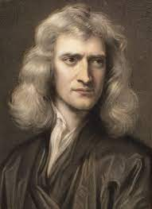
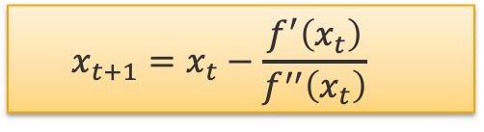
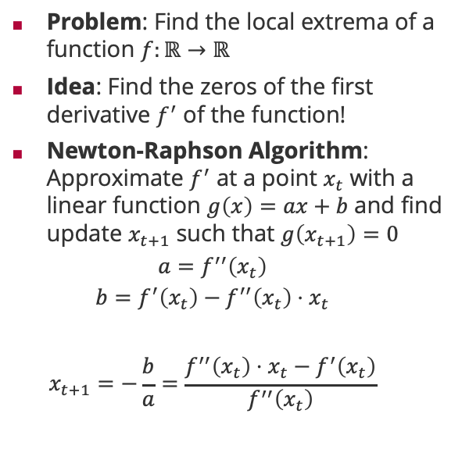
Newton-Raphson Algorithm
Problem: Find the local extrema of a function $f:ℝ→ℝ$
Idea: Find the zeros of the first derivative $f^{′}$ of the function!
Newton-Raphson Algorithm: Approximate $f^{′}$ at a point $x_{t}$ with a linear function $g\left(x\right)=ax+b$ and find update $x_{t+1}$ such that $g\left(x_{t+1}\right)=0$
$$a=f^{′′}\left(x_{t}\right)$$
$$b=f^{′}\left(x_{t}\right)−f^{′′}\left(x_{t}\right)⋅x_{t}$$
$$x_{t+1}=−\frac{b}{a}=\frac{f^{′′}\left(x_{t}\right)⋅x_{t}−f^{′}\left(x_{t}\right)}{f^{′′}\left(x_{t}\right)}$$
Sir Isaac Newton (1643 – 1727)
$$x_{t+1}=x_{t}−\frac{f^{′}\left(x_{t}\right)}{f^{′′}\left(x_{t}\right)}$$

Slide 16

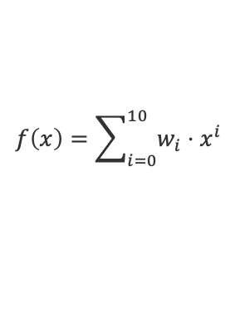
Maximum A-Posteriori Inference: Polynomial Regression
$$f\left(x\right)=w_{1}x+w_{2}x^{2}$$
$f\left(x\right)=w_{0}+w_{1}x+w_{2}x^{2}+w_{3}x^{3}$ $+w_{4}x^{4}+w_{5}x^{5}$ $+w_{6}x^{6}$
$$f\left(x\right)=\sum_{i=0}^{10}{w_{i}⋅x^{i}}$$

Slide 17
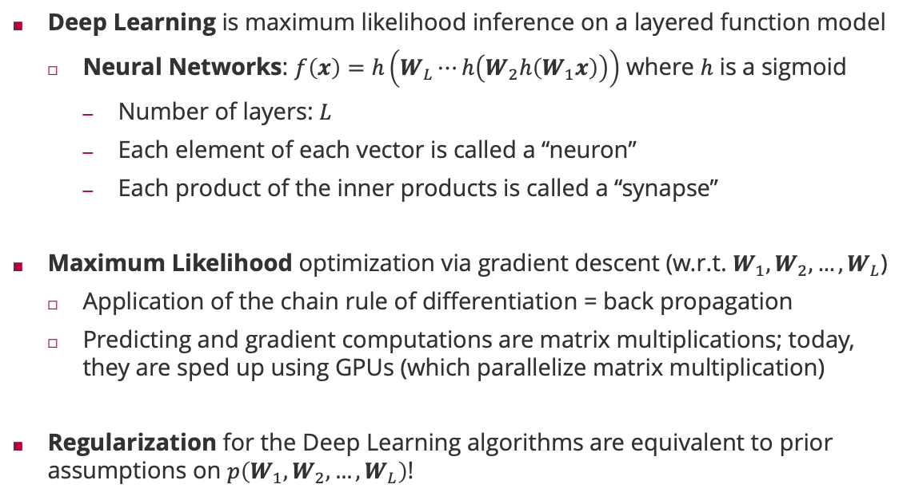
Relation to Deep Learning
Deep Learning is maximum likelihood inference on a layered function model
Neural Networks: $f\left(x\right)=h\left(W_{L}⋯h\left(W_{2}h\left(W_{1}x\right)\right)\right)$ where $h$ is a sigmoid
Number of layers: $L$
Each element of each vector is called a “neuron”
Each product of the inner products is called a “synapse”
Maximum Likelihood optimization via gradient descent (w.r.t. $W_{1},W_{2},…,W_{L}$)
Application of the chain rule of differentiation = back propagation
Predicting and gradient computations are matrix multiplications; today, they are sped up using GPUs (which parallelize matrix multiplication)
Regularization for the Deep Learning algorithms are equivalent to prior assumptions on $p\left(W_{1},W_{2},…,W_{L}\right)$!

Slide 18
Overview
Inference Methods
Bayesian Inference
Maximum Likelihood Estimation
Decision Making

Slide 19

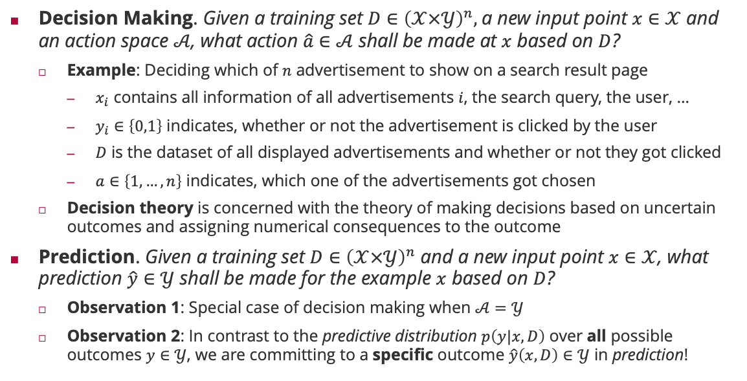
Key Question II: Decision Making and Prediction
search query
Decision Making. Given a training set $D∈{\left(𝒳×𝒴\right)}^{n},$a new input point $x∈𝒳$ and an action space $𝒜$, what action $\hat{a}∈𝒜$ shall be made at $x$ based on $D$?
Example: Deciding which of $n$ advertisement to show on a search result page
$x_{i}$ contains all information of all advertisements $i$, the search query, the user, …
$y_{i}∈\left\{0,1\right\}$ indicates, whether or not the advertisement is clicked by the user
$D$ is the dataset of all displayed advertisements and whether or not they got clicked
$a∈\left\{1,…,n\right\}$ indicates, which one of the advertisements got chosen
Decision theory is concerned with the theory of making decisions based on uncertain outcomes and assigning numerical consequences to the outcome
Prediction. Given a training set $D∈{\left(𝒳×𝒴\right)}^{n}$ and a new input point $x∈𝒳$, what prediction $\hat{y}∈𝒴$ shall be made for the example $x$ based on $D$?
Observation 1: Special case of decision making when $𝒜=𝒴$
Observation 2: In contrast to the predictive distribution $p\left(y|x,D\right)$ over all possible outcomes $y∈𝒴$, we are committing to a specific outcome $\hat{y}\left(x,D\right)∈𝒴$ in prediction!
advertisements (paid-for content)

Slide 20
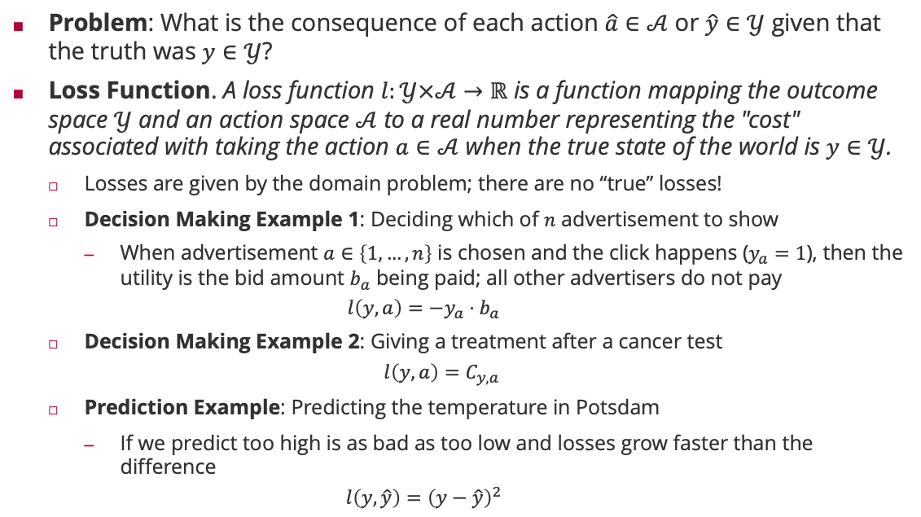
Loss Functions
Problem: What is the consequence of each action $\hat{a}∈𝒜$ or $\hat{y}∈𝒴$ given that the truth was $y∈𝒴$?
Loss Function. A loss function $l:𝒴×𝒜→ℝ$ is a function mapping the outcome space $𝒴$ and an action space $𝒜$ to a real number representing the "cost" associated with taking the action $a∈𝒜$ when the true state of the world is $y∈𝒴$.
Losses are given by the domain problem; there are no “true” losses!
Decision Making Example 1: Deciding which of $n$ advertisement to show
When advertisement $a∈\left\{1,…,n\right\}$ is chosen and the click happens ($y_{a}=1$), then the utility is the bid amount $b_{a}$ being paid; all other advertisers do not pay
$$l\left(y,a\right)=−y_{a}⋅b_{a}$$
Decision Making Example 2: Giving a treatment after a cancer test
$$l\left(y,a\right)=C_{y,a}$$
Prediction Example: Predicting the temperature in Potsdam
If we predict too high is as bad as too low and losses grow faster than the difference
$$l\left(y,\hat{y}\right)={\left(y−\hat{y}\right)}^{2}$$
 |  | Actions
 |  | treat | nothing
Outcomes | Cancer | 0 | 1000
 | No cancer | 1 | 0

Slide 21
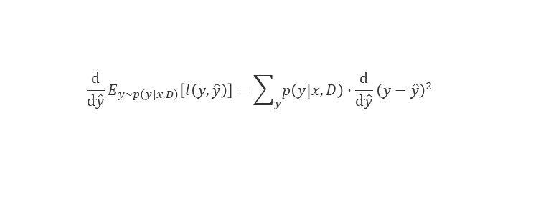
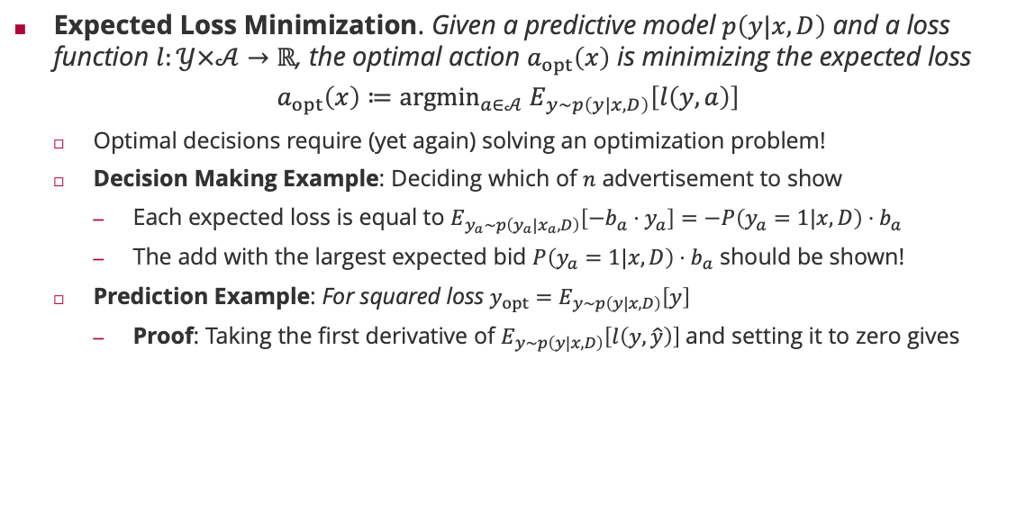


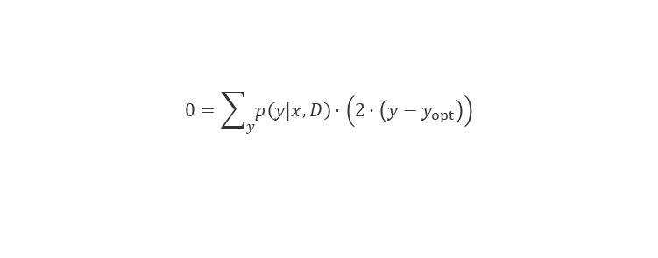
Optimal Decisions: Expected Loss Minimization Principle
Expected Loss Minimization. Given a predictive model $p\left(y|x,D\right)$ and a loss function $l:𝒴×𝒜→ℝ$, the optimal action $a_{opt}\left(x\right)$ is minimizing the expected loss
$$a_{opt}\left(x\right)≔{argmin}_{a∈𝒜} E_{y∼p\left(y|x,D\right)}\left[l\left(y,a\right)\right]$$
Optimal decisions require (yet again) solving an optimization problem!
Decision Making Example: Deciding which of $n$ advertisement to show
Each expected loss is equal to $E_{y_{a}∼p\left(y_{a}|x_{a},D\right)}\left[−b_{a}⋅y_{a}\right]=−P\left(y_{a}=1|x,D\right)⋅b_{a}$
The add with the largest expected bid $P\left(y_{a}=1|x,D\right)⋅b_{a}$ should be shown!
Prediction Example: For squared loss $y_{opt}=E_{y∼p\left(y|x,D\right)}\left[y\right]$
Proof: Taking the first derivative of $E_{y∼p\left(y|x,D\right)}\left[l\left(y,\hat{y}\right)\right]$and setting it to zero gives
$$\frac{d}{d\hat{y}}E_{y∼p\left(y|x,D\right)}\left[l\left(y,\hat{y}\right)\right]=\sum_{y}{p\left(y|x,D\right)}⋅\frac{d}{d\hat{y}}{\left(y−\hat{y}\right)}^{2}$$
$$0=\sum_{y}{p\left(y|x,D\right)}⋅\left(2⋅\left(y−y_{opt}\right)\right)$$
$$0=2⋅\left(\sum_{y}{p\left(y|x,D\right)}⋅y−\sum_{y}{p\left(y|x,D\right)}⋅y_{opt}\right)$$
$$0=E_{y∼p\left(y|x\right)}\left[y\right]−y_{opt}$$

Slide 22
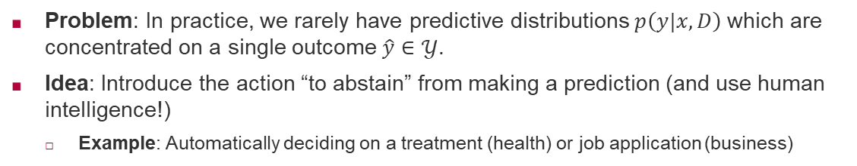
Decision Making under Uncertainty
Problem: In practice, we rarely have predictive distributions $p\left(y|x,D\right)$which are concentrated on a single outcome $\hat{y}∈𝒴$.
Idea: Introduce the action “to abstain” from making a prediction (and use human intelligence!)
Example: Automatically deciding on a treatment (health) or job application (business)
Optimal Binary Prediction (without abstaining)
Optimal Binary Prediction (with abstaining)
Decide for 0
Decide for 1
Decide for 0
Abstain
Decide for 1

Slide 23
Summary
Inference Methods
Inference is the task of inferring what we know about the plausibility of a prediction function in light of training data
Bayesian Inference is the only consistent inference technique, but it requires huge summations which is (usually) computationally too hard
Maximum Likelihood Estimation is often easier and reduces machine learning to parameter optimization – but we are losing model uncertainty
Decision Making
Decision making solves the second big problem: making automated decisions based on future predictions
We always require domain-specific loss functions
Except in a few special cases (e.g., squared loss), automated decision making requires heavy optimization (again!)
We will not dive deeper into decision making methods in the rest of the lecture

Slide 24
See you next week!

